Slide 1
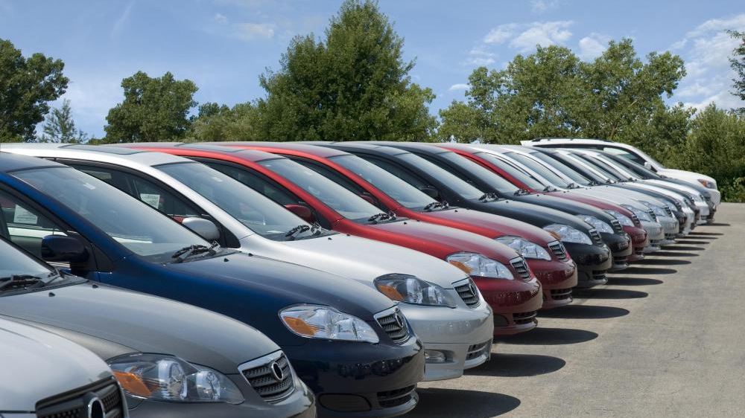
Used Vehicle Price Prediction
Aman Garg, Subodh Khanal, Hulester Bing, Chandler Dunklin, Antony Gikanga

Slide 2
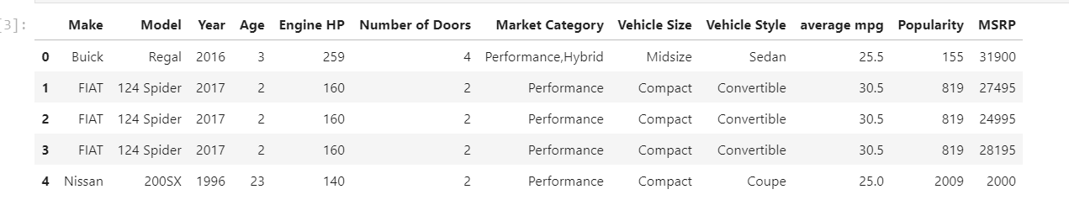
Background/Methodology
The used car market is notoriously difficult to navigate. How do you determine a fair price?
The goal of the project was to use objective measurements to predict the price
Parameters used:

Slide 3
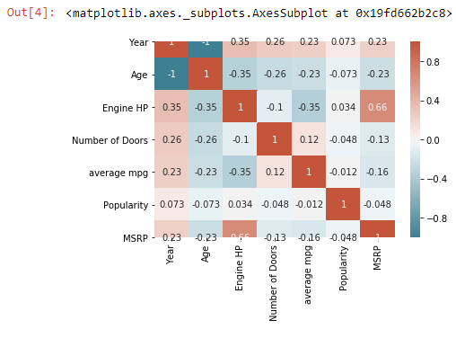
Correlation Matrix
Developed matrix to determine which car features were most related to MSRP.
Engine HP with a score of .66 was determined to have the highest correlation

Slide 4
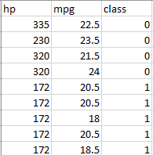
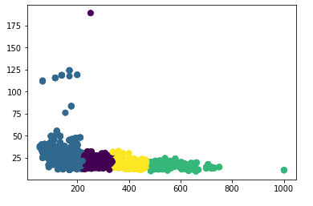
Clustering – K means
Used HP and MPG to create four clusters representing different car classifications

Slide 5
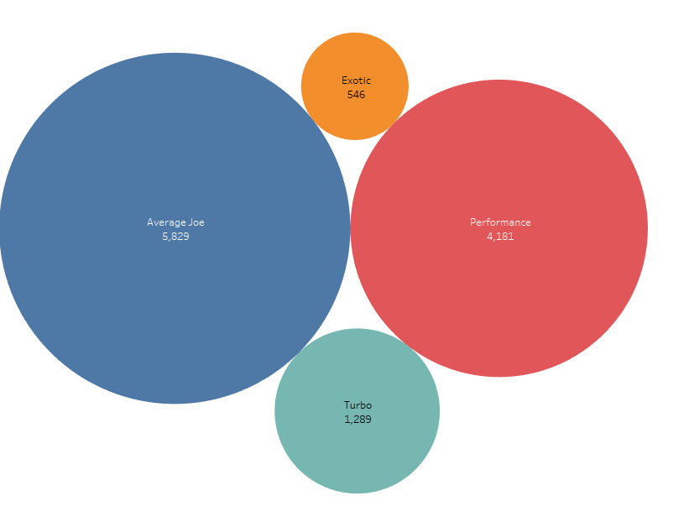
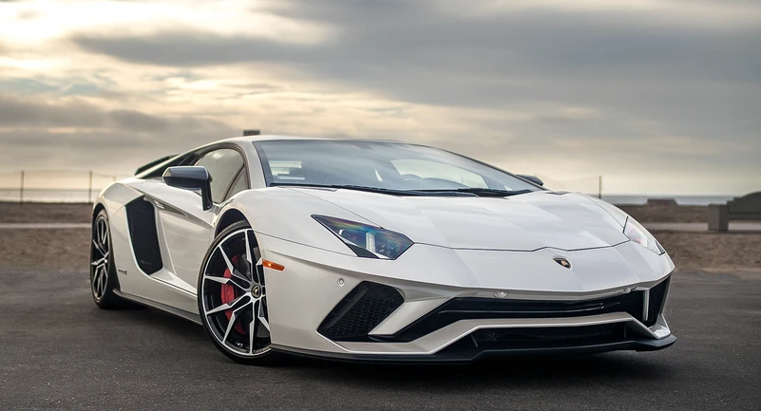
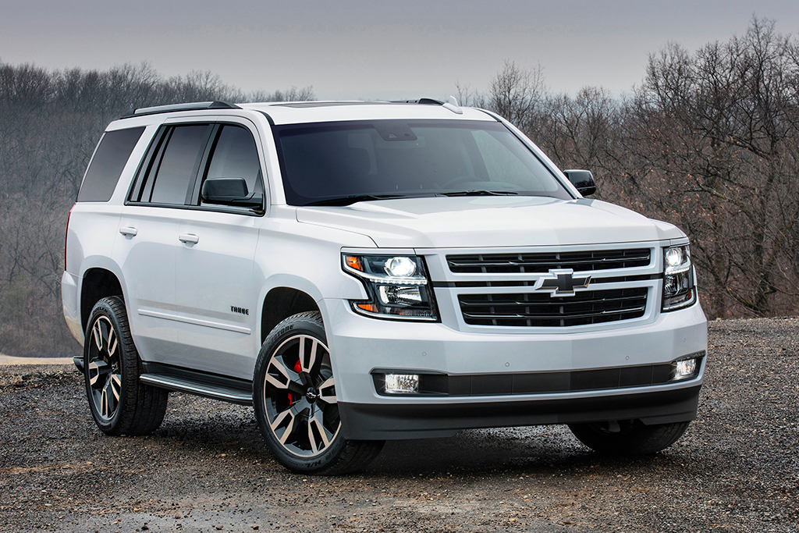
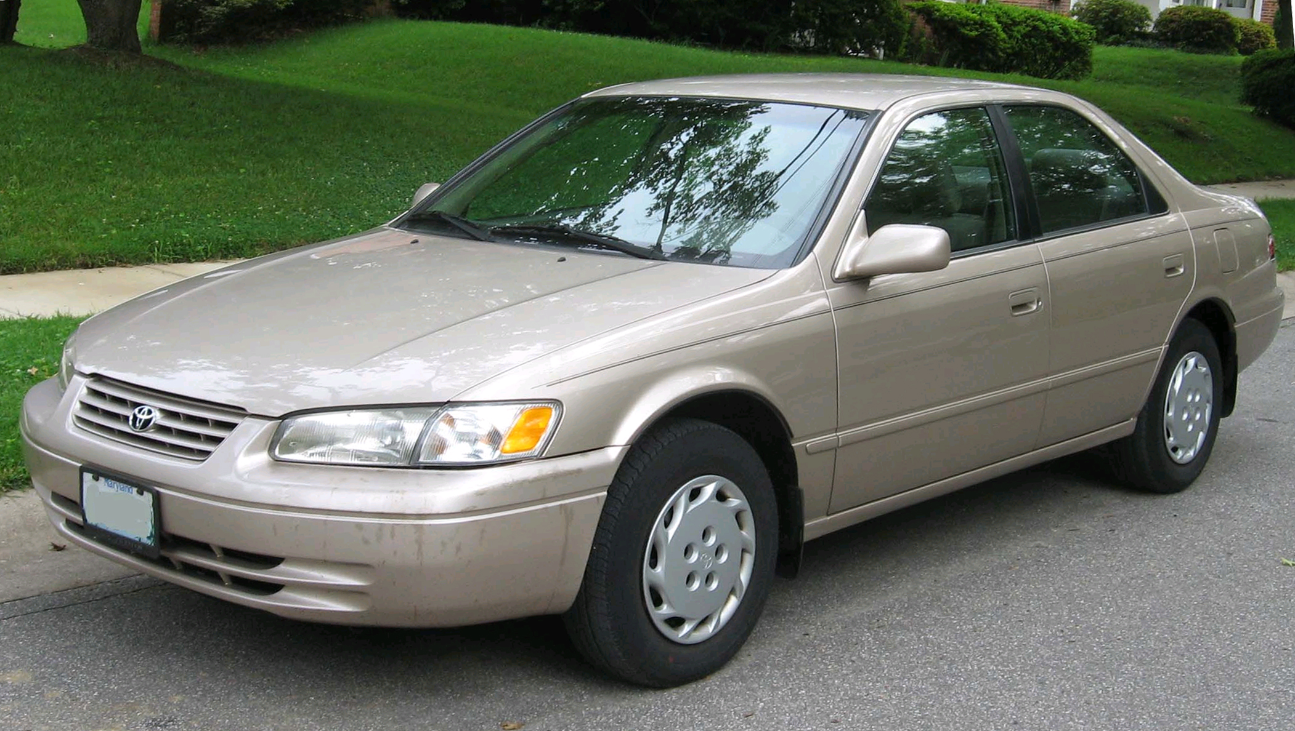
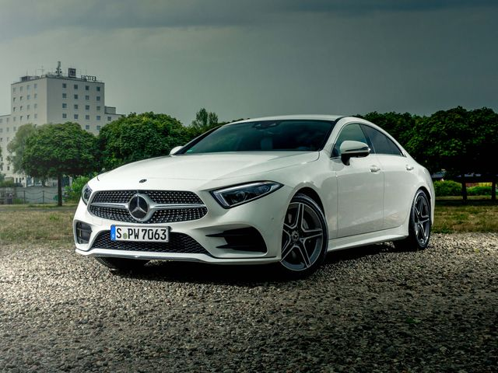
Car Classifications

Slide 6
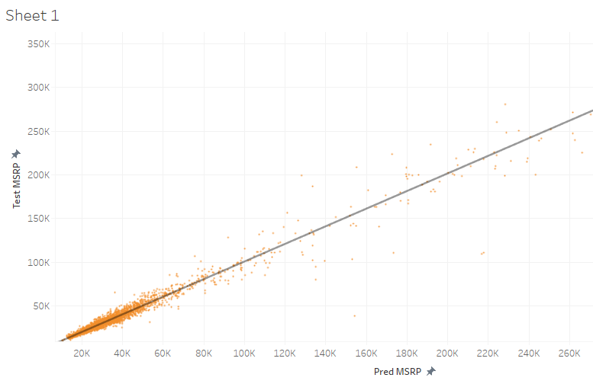
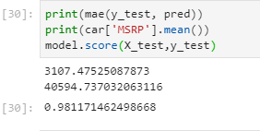
Random Forest Regressor
Model Score:

Slide 7
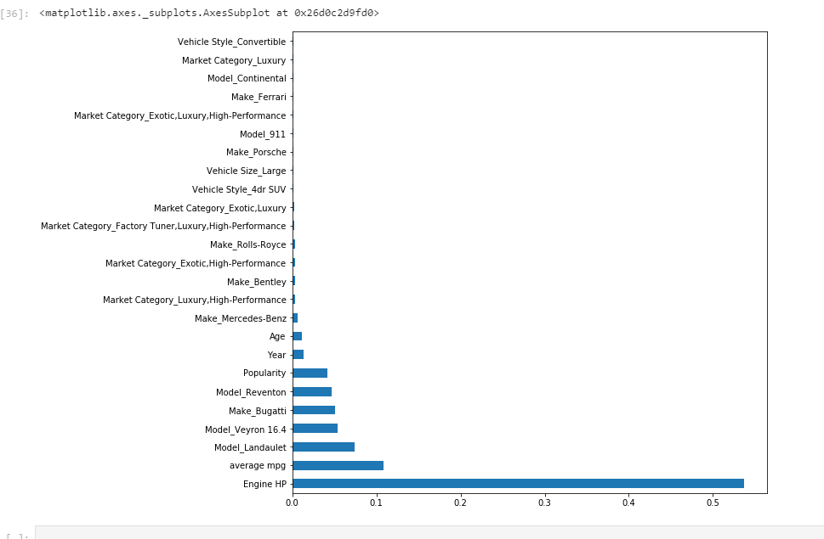
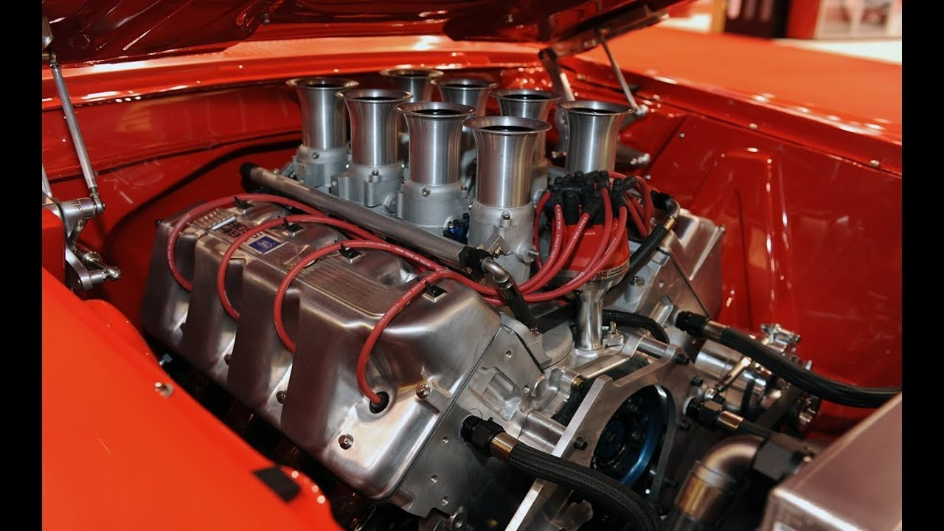
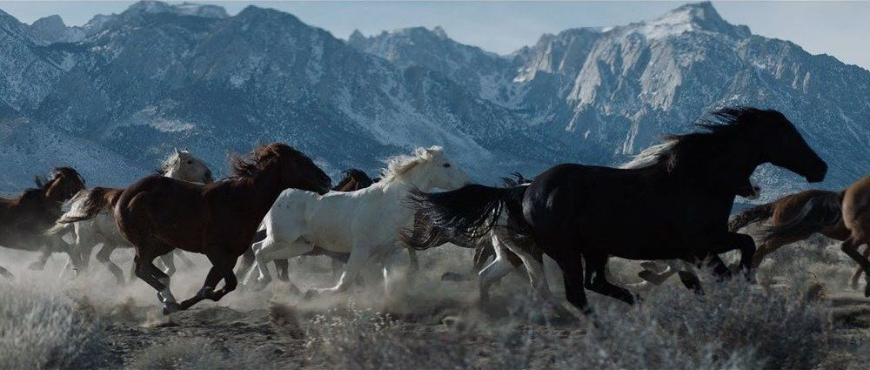
Important Features

Slide 8
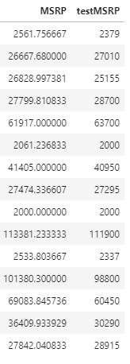
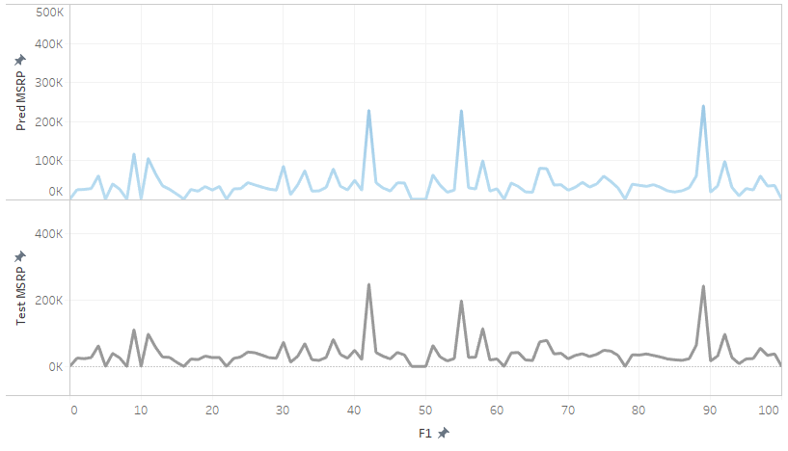
Test vs Predicted MSRP

